Slide 1
INVESTMENT ASSIGNMENT SUBMISSION
Swarnim Suman

Slide 2
Spark funds Investment Case Study
Objective
Spark Funds wants to invest where most other investors are investing.
Constraints:
Spark Funds wants to invest between 5 to 15 million USD per round of investment.
Spark Funds wants to invest only in English-speaking countries.
Identify:
Spark Funds wants to identify best suited fund among the 4 major types – Venture, Seed, Angel and Private equity
Spark Funds wants to identify the English speaking countries for the ease of communication.
Spark Funds wants to identify the sector where other investors are investing

Slide 3
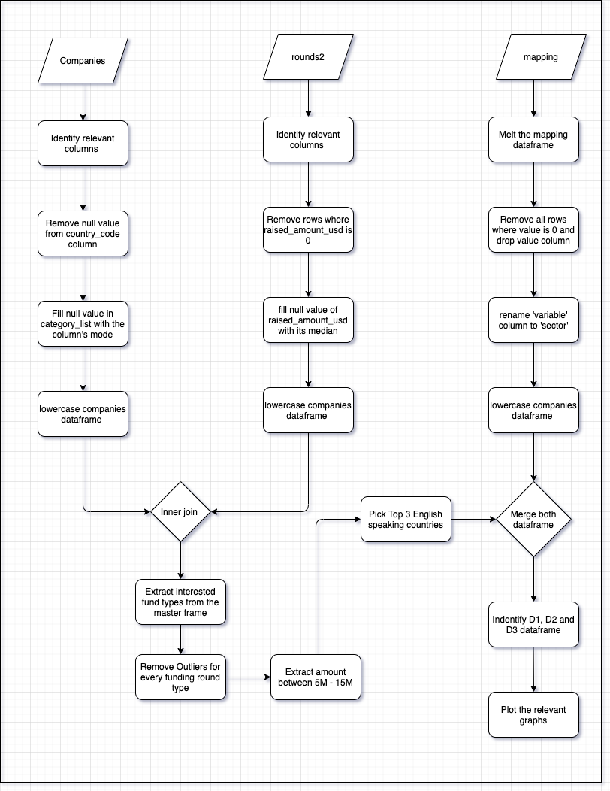
Methodology

Slide 4
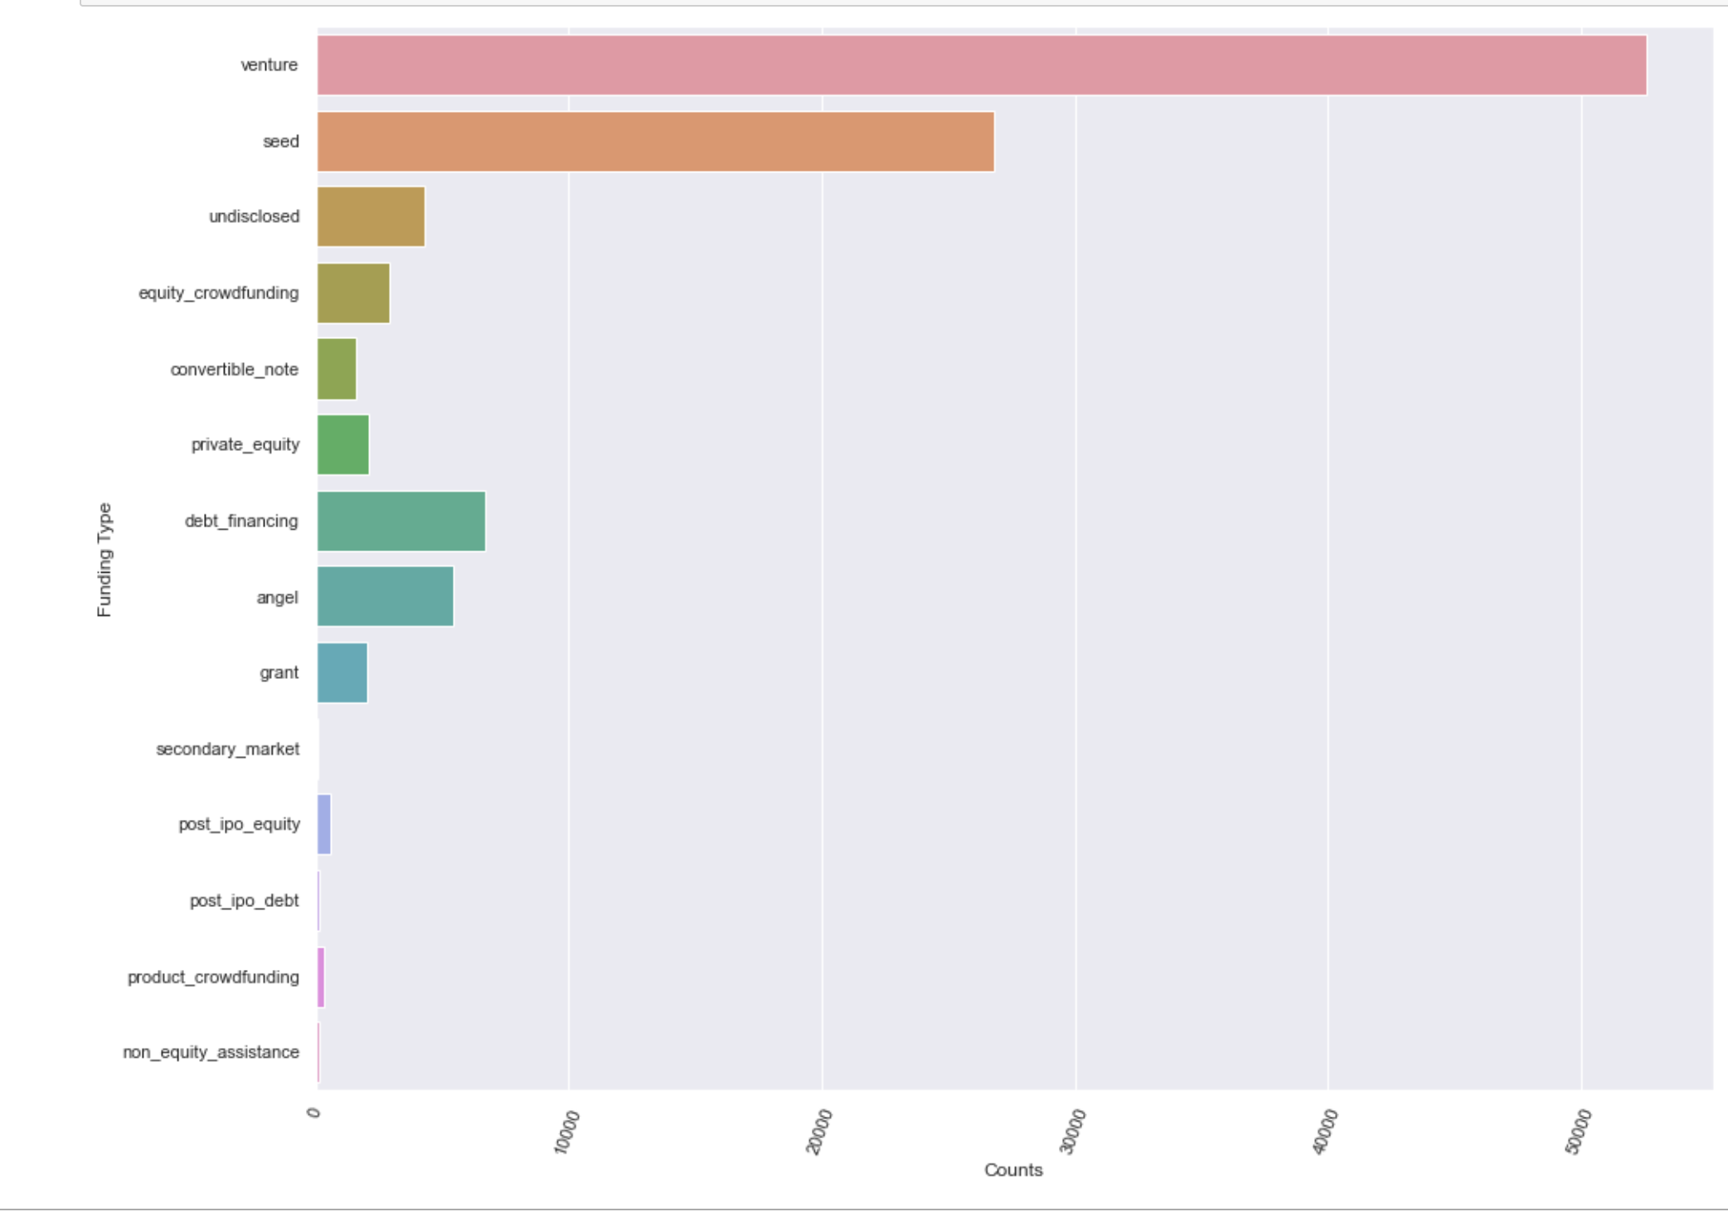
Frequency of Funding Types
Highest number of Funding: Venture Capitalist

Slide 5
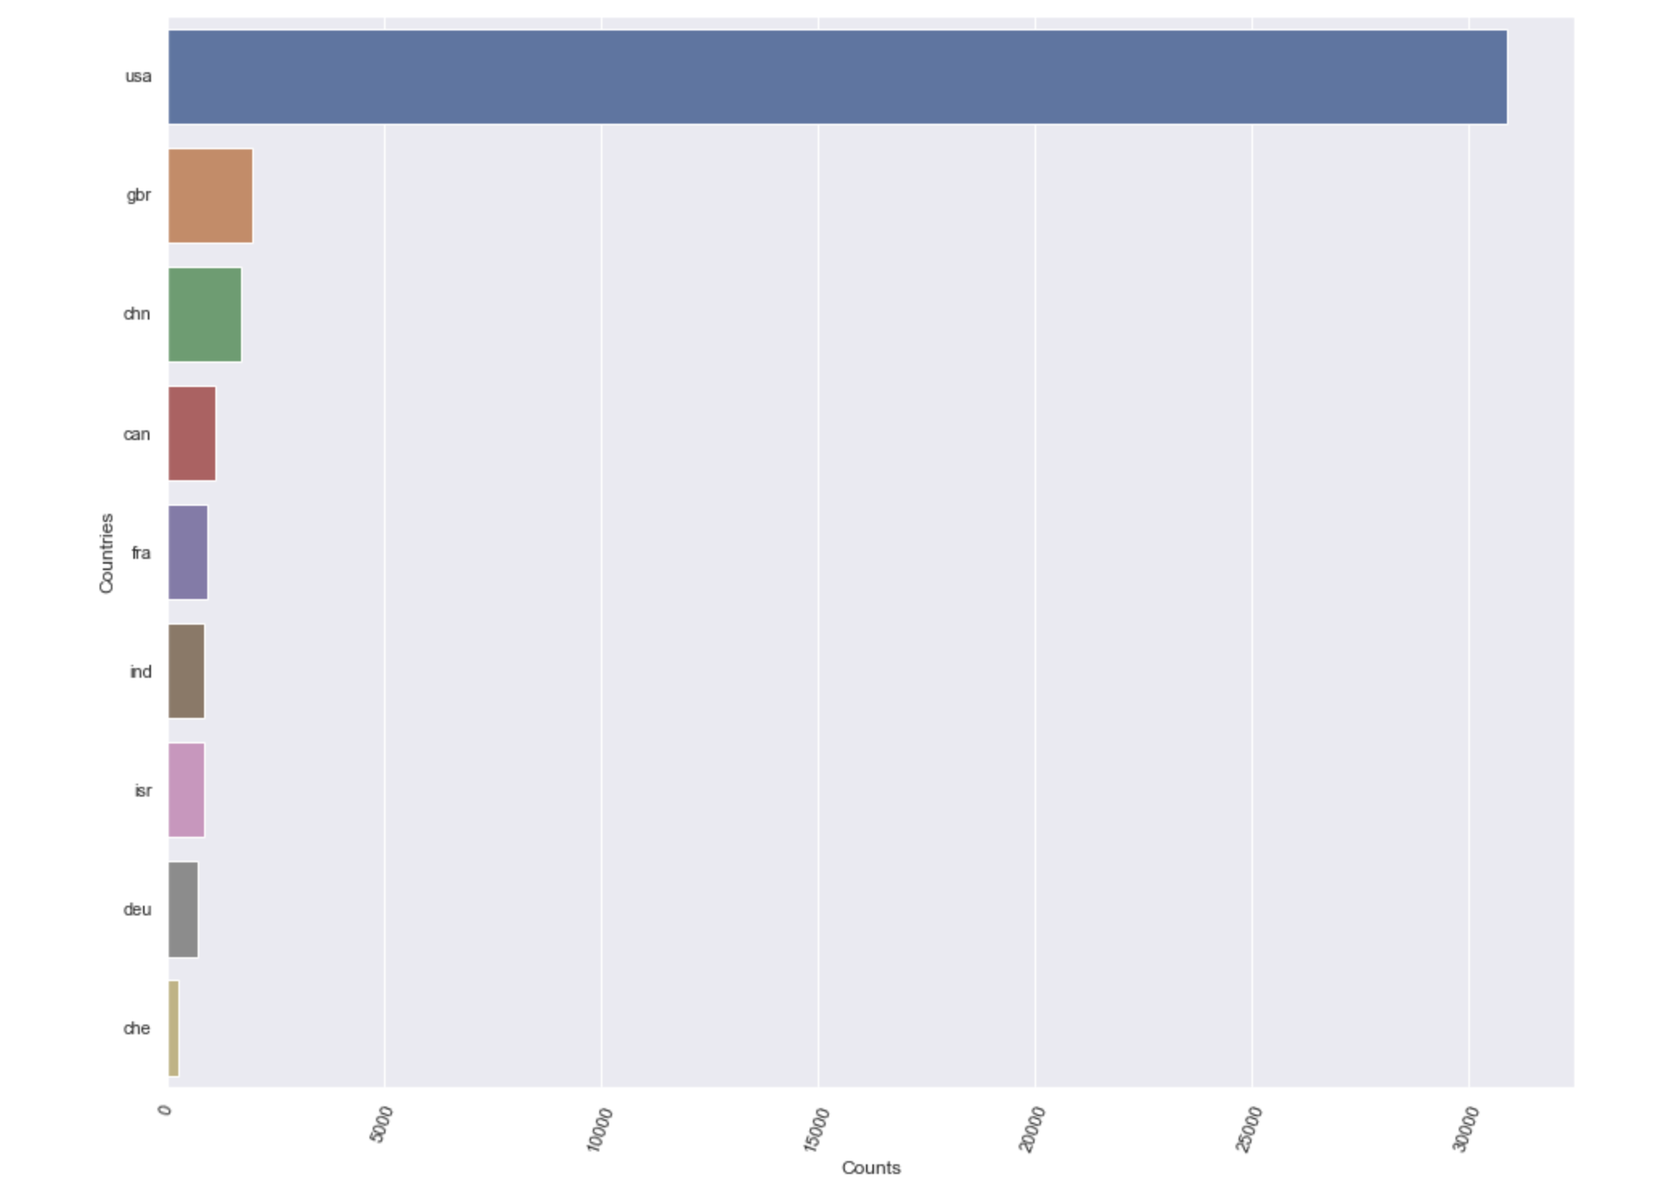
Country wise investment
Top 3 English speaking Countries with most investment in Venture Type:
1. USA
2. Great Britain
3. Canada

Slide 6
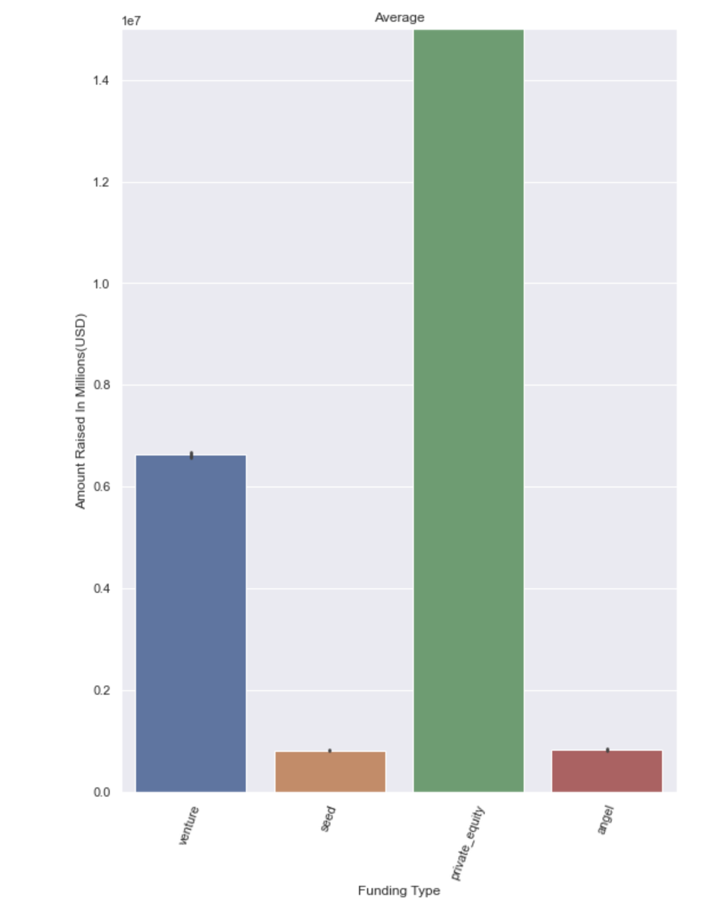
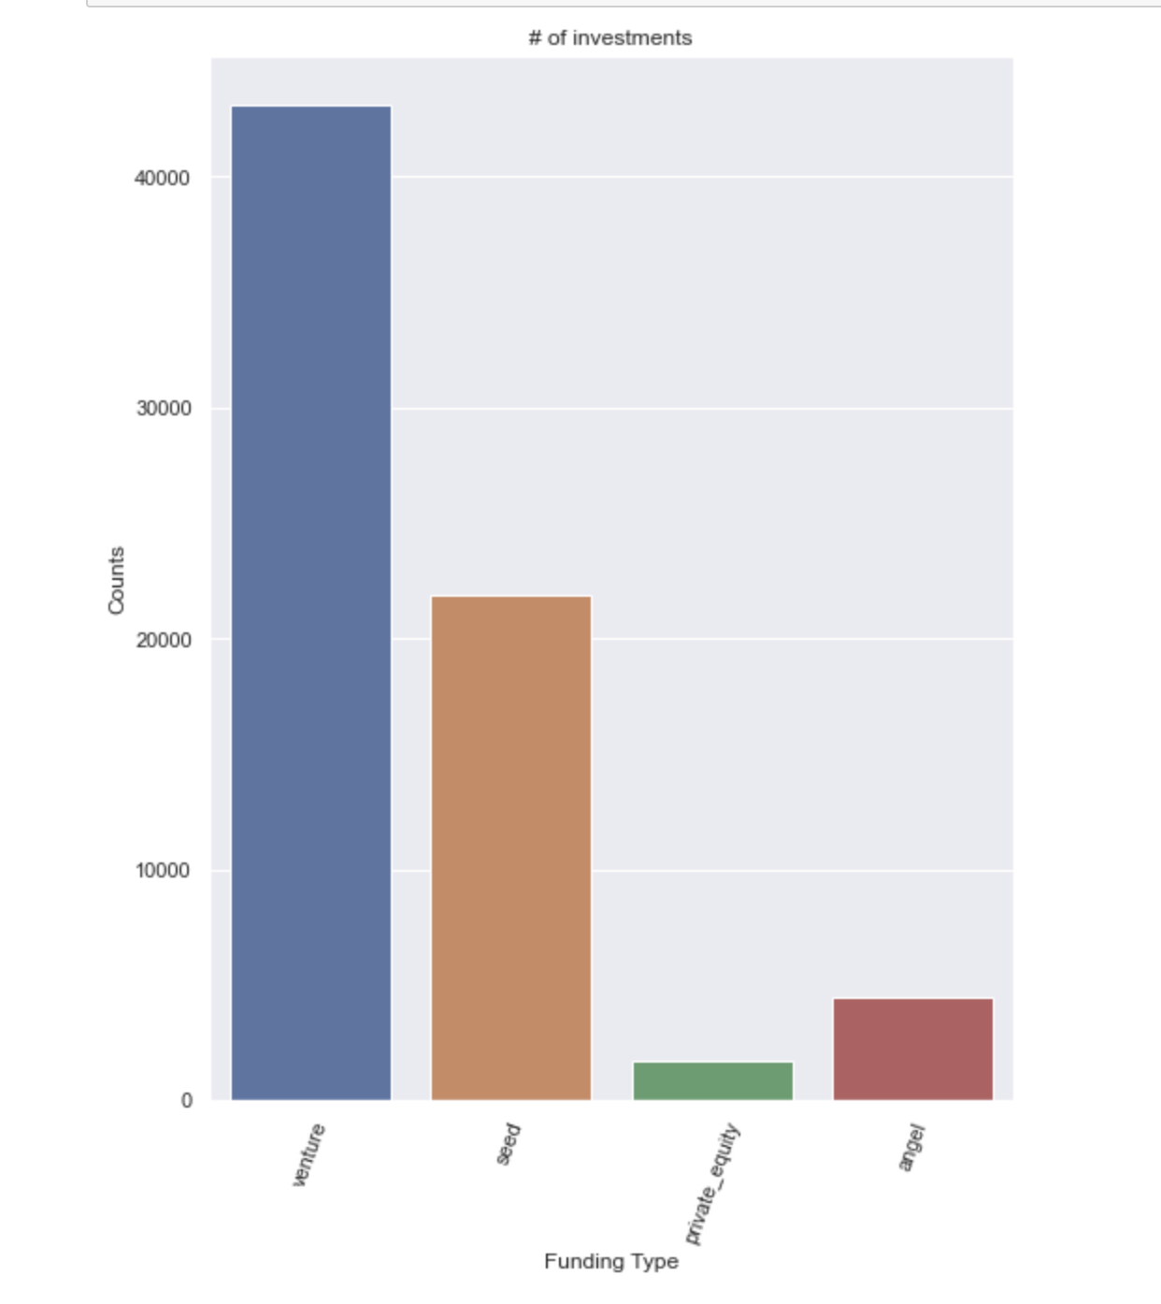
The representative amount of investment in each funding type

Slide 7
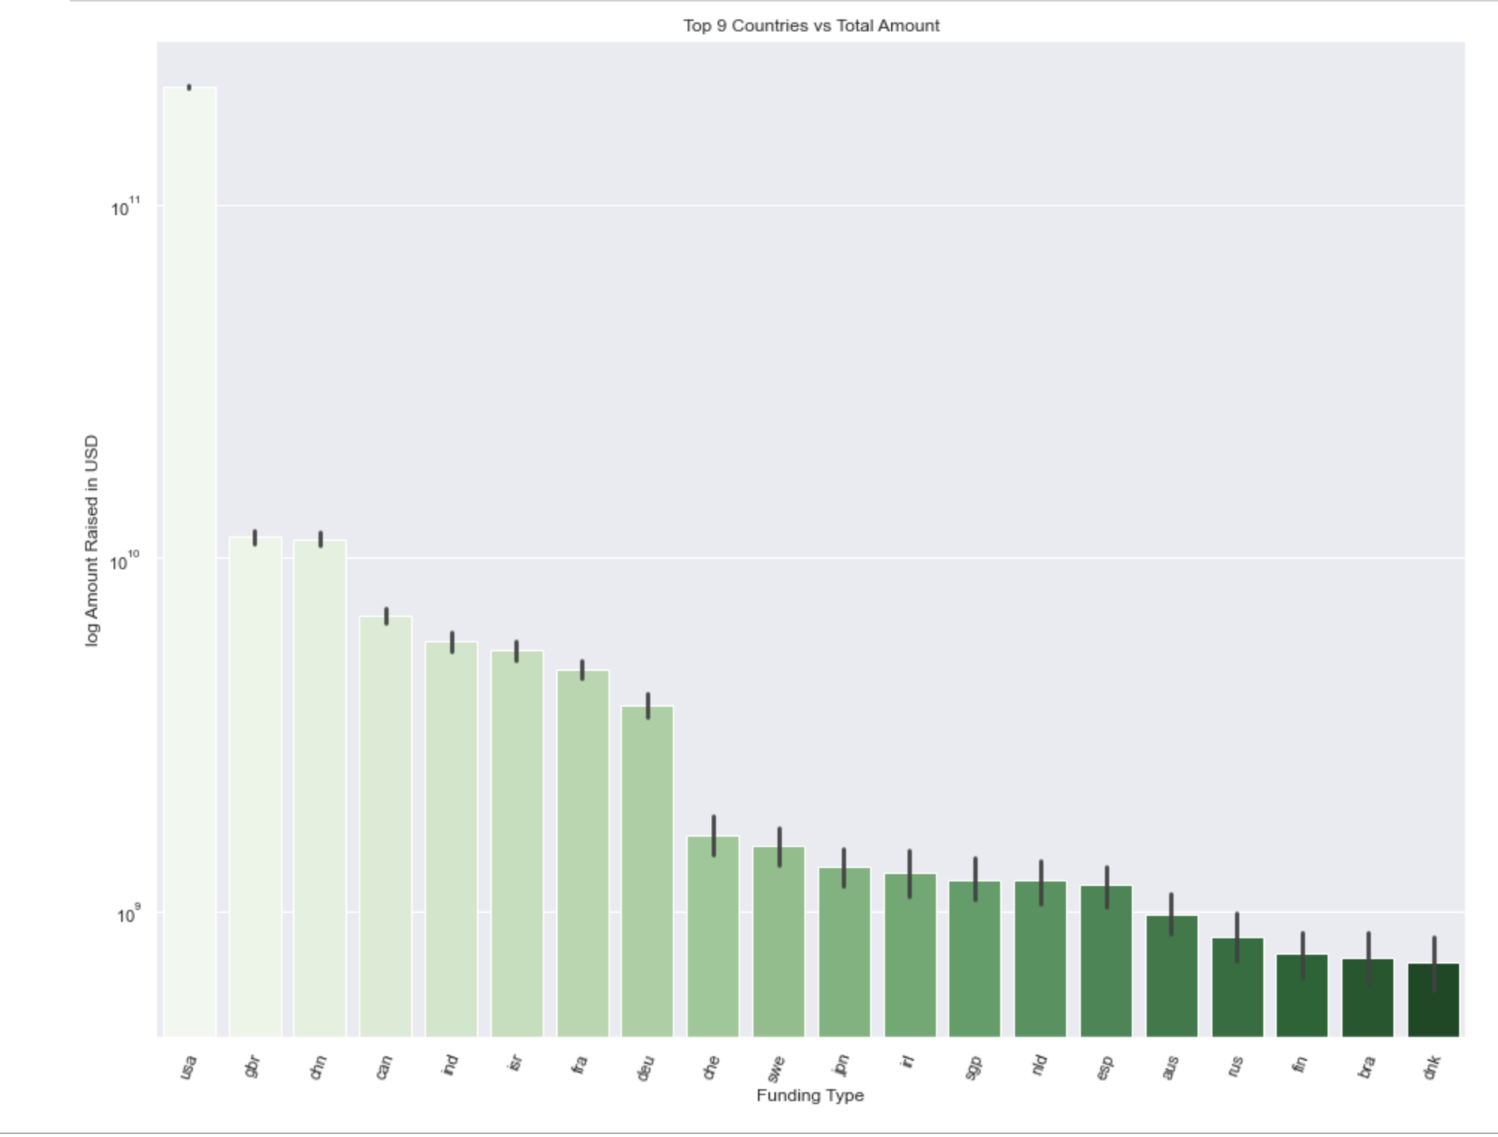
Top 9 countries with total amount of investment of Venture Capitalist

Slide 8
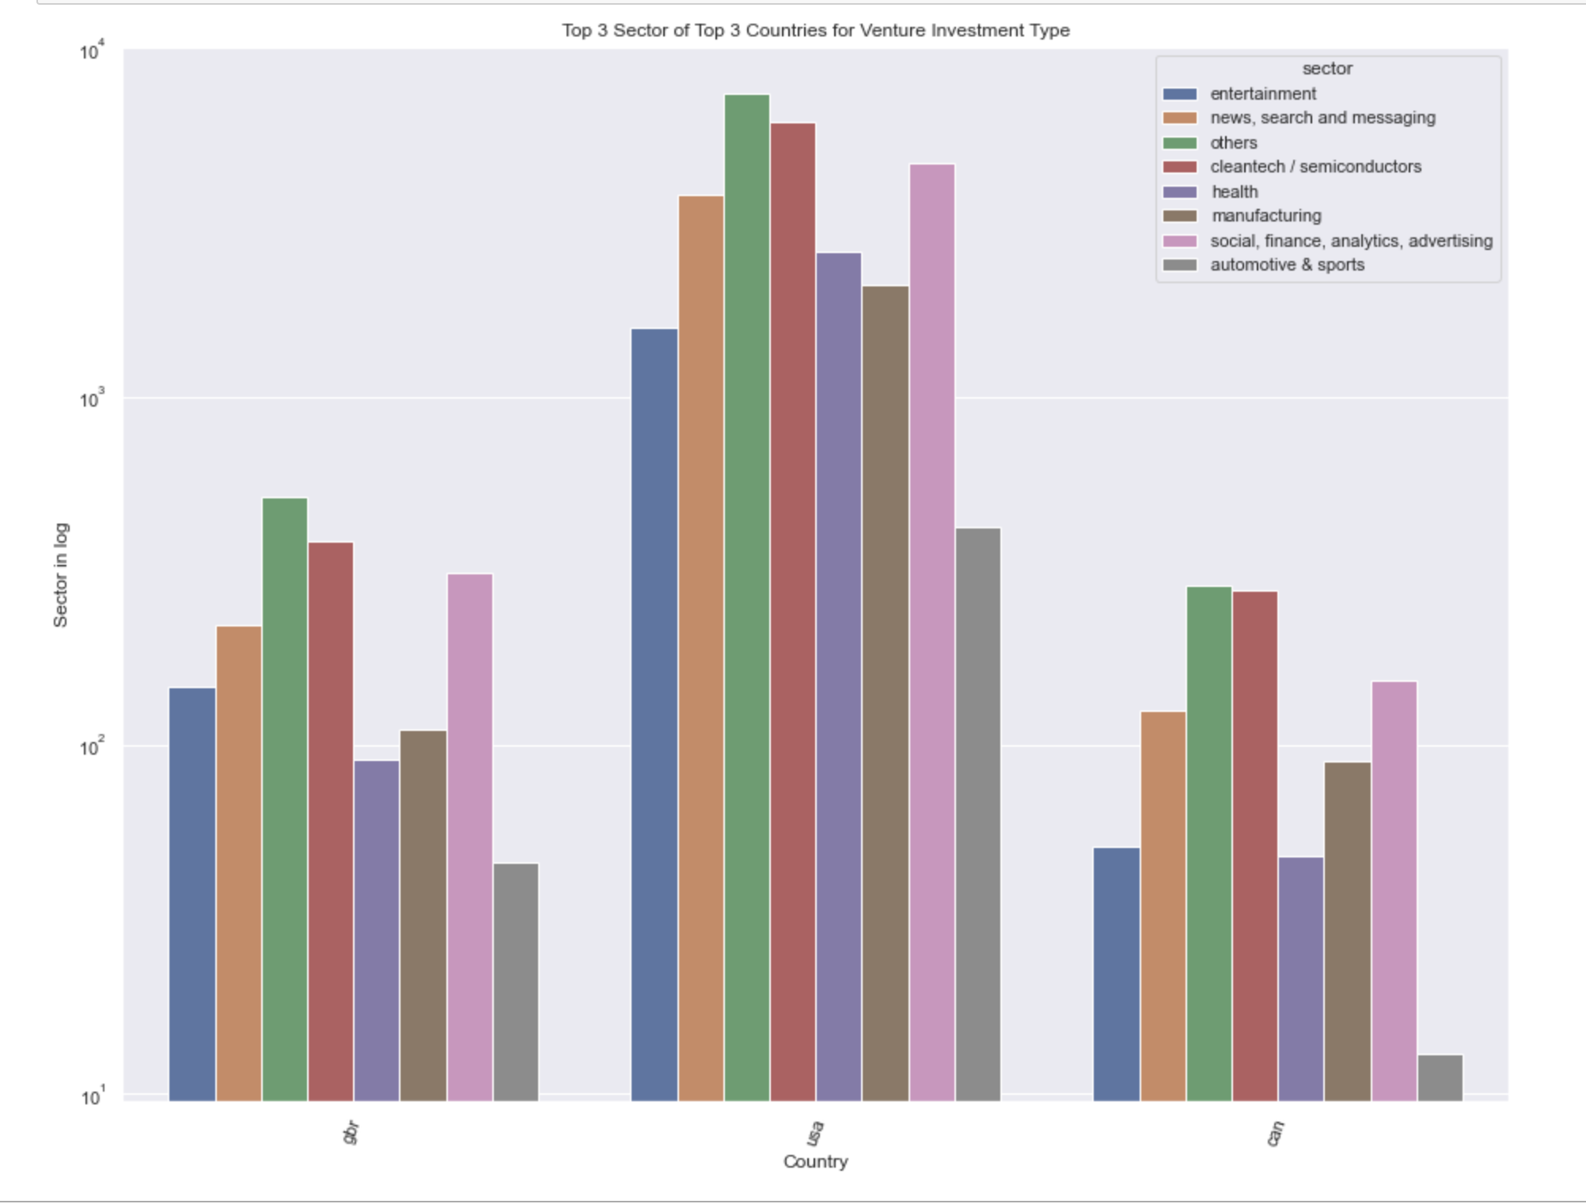
Top 3 Sector of Top 3 Countries for Venture Investment Type

Slide 9
Conclusions
Based on the analysis of Investment data, we can conclude the following:
Venture capitalist is the most suitable funding type for Spark Funds to invest which meets the constraint of spending 5-15M per investment round.
Top 3 English speaking countries with most investment in venture type funding:
USA
Great Britain
Canada
Top 3 Sectors most suitable sector for funding
Others
Cleantech / Semiconductors
Social, Finance, Analytics and Advertising

